Slide 1
Project Overview
Contributors:
Mahnoor
Krithika
Hassaan
Santhosh
Harshit
Hiten
Shaheer
Yogesh
By: Team 12

Slide 2
Data Analyst Intern – Excelerate
Role: Data Analyst Intern (Team 12)
Goal: Transform raw datasets into actionable insights via PostgreSQL, SQL, Python, and Google Looker Studio
Final outcome: Interactive dashboard and presentation with recommendations

Slide 3
Internship Timeline
4-week roadmap
Week | Focus | Deliverables
1 | EDA & data assessment | EDA report
2 | Master Table & ETL logic | SQL scripts + Data quality report
3 | Mapping & dashboard planning | Mapping Table + Wireframe
4 | Final delivery & reflection | Dashboard link + final presentation + feedback

Slide 4
Week 1: EDA Objectives
Summarize the dataset structure, attribute types, and row counts
Detect all the missing values, duplicates, and outliers
Explore multiple distributions, trends, and relationships with the help of histograms, box plots, heatmaps, and line charts
Produce actionable observations to guide Week 2

Slide 5
Week 1: Data Health Checklist
Used PostgreSQL to read metadata
01
Initial issues found:
02
information_schema.columns → data types
SELECT COUNT(*), COUNT(NULL) → row‑level diagnostics
6 duplicate rows in
~41 % NULL values in learner_raw (degree, major, institution)
186 duplicates in learneropportunity_raw
6 duplicate rows in marketing_campaign_raw

Slide 6
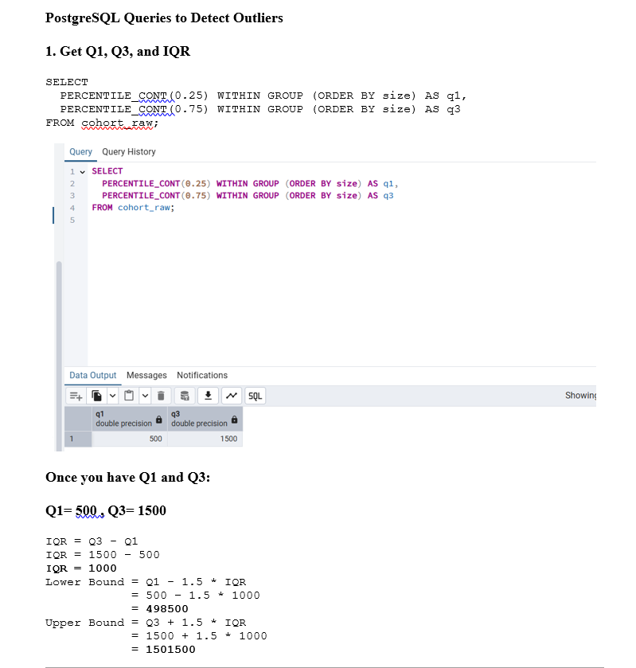
Week 1: Summary Statistics & Outlier Detection
Calculated key metrics: MIN, MAX, MEAN, MEDIAN, STDDEV on numerical fields
Example:
Campaign Reach peaked at 141M+
Cost Per Result outliers beyond 5.0
Used Interquartile Range (IQR) method to flag outliers on age, cohort size, reach
IQR → values beyond Q₁ − 1.5 × IQR or Q₃ + 1.5 × IQR considered anomalous

Slide 7
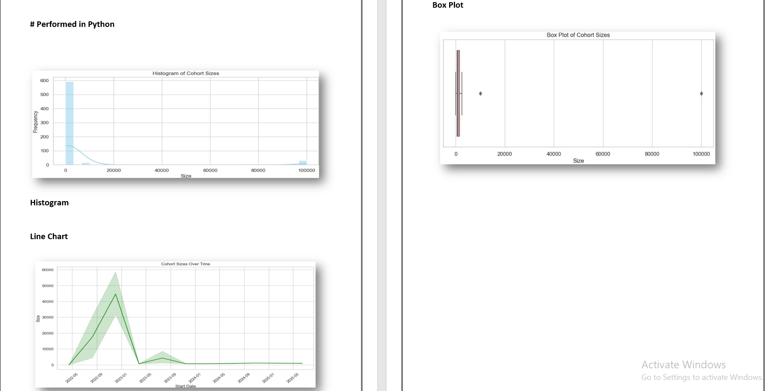
Week 1: Python‑Based Visual Insights
Visualized metrics using Python (pandas + matplotlib/seaborn):
Histograms (Age distribution, Reach spread)
Box plots (Cohort size, Cost Per Result)
Line charts (Monthly enrollment trends from cognito_raw)
Heatmaps (Correlation among numeric dimensions)
Visual findings helped frame transformation strategy

Slide 8
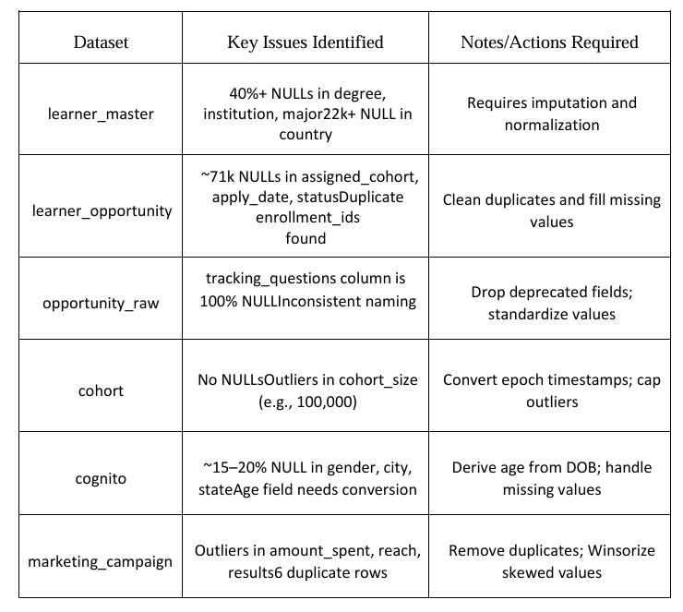
Week 1: Key Findings & Impacts
Missing data: Significant nulls affecting cohort and campaign attributes
Outliers: Extreme cost and size measures indicating campaigns with anomalies
Duplicates: Risk of skewing aggregate metrics or join logic
Conclusion: Robust cleaning and standardization essential for Week 2

Slide 9
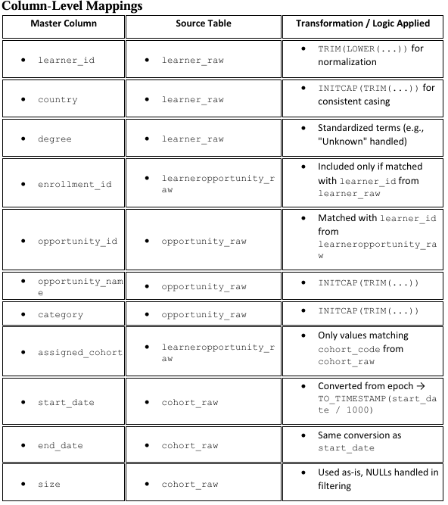
Week 2: Master Table Creation
Built a unified master_table merging six datasets: learner_raw, opportunity_raw, cohort_raw, learneropportunity_raw, cognito_raw, marketing_campaign_raw
Included normalized columns:
learner_id, opportunity_id, cohort_code, degree, country, campus
Timestamps converted to readable dates (e.g. start_date)
Defined columns with constraints (NOT NULL, PRIMARY KEY) and indexes on frequently used join keys

Slide 10
Week 2: SQL Script & Stored Procedure
Table Definition: CREATE TABLE master_table ( … )
ETL Stored Procedure:
Cleans input data (TRIM, INITCAP, LOWERCASING)
Joins six raw tables, preserving original datasets
Filters null/unexpected entries, formats date fields
Ensures reusable, traceable, and auditable data processing

Slide 11
Week 2: Addressing Data Quality
Detected issues include:
01
Cleaning actions:
02
~71K nulls in assigned_cohort, apply_date
~84K rows with empty timestamps
Inconsistent country codes, mixed casing, whitespace anomalies
TRIM, INITCAP, TO_TIMESTAMP conversion, exclusion of NULL where required

Slide 12
Week 2: Validation Methodology
Before and after cleaning comparisons using row counts and sampling
Sampled more than 100 rows to ensure transformations applied correctly
Verified the foreign‑key referential integrity (learner → opportunity → cohort)
Ensured the entity uniqueness and that there is no duplicate Enrollment IDs in final master_table
Compliance with data quality dimensions including completeness, consistency, accuracy, uniqueness

Slide 13
Week 2: Summary Table of Cleaning Logic
Issue | Tool / SQL Function | Purpose
Whitespace | TRIM() | Clean input fields
Mixed casing | INITCAP() or LOWER() | Standardize textual data
Timestamps | TO_TIMESTAMP(epoch, ’YYYY…') | Convert epoch to date
NULL handling | WHERE column IS NOT NULL | Exclude missing critical data

Slide 14
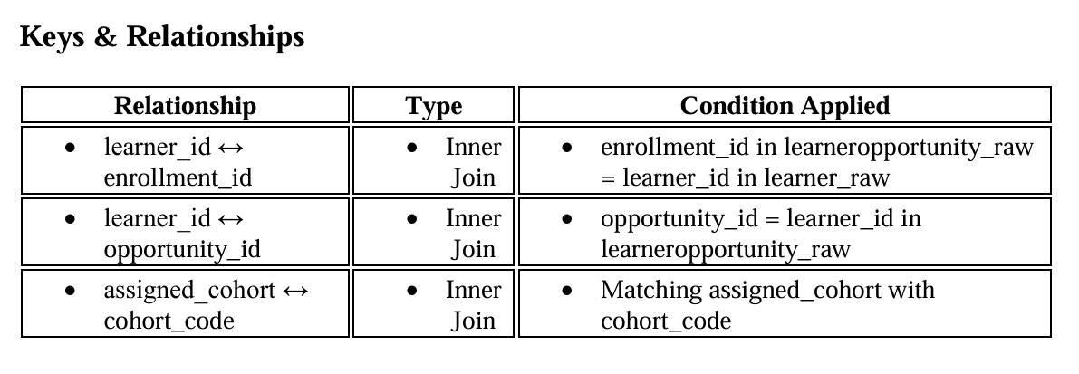
Week 3: Mapping Table Structure
Created Excel mapping table aligning raw fields with dashboard KPIs:
Columns: learner_id, opportunity_id, cohort_code, start_date
Detailed transformations per field (e.g. country standardization, date formatting)
Ensured clean relational link among all sources for downstream visualization

Slide 15
Week 3: KPI Definition
KPI | Definition | Source / Chart Type
Total Enrollments | Unique learner_id count | Scorecard
Average Program Size | Average cohort_size per opportunity | Scorecard
Learner Distribution | Learners by country, degree | Bar or Geo chart
Enrollment Trend | Monthly apply_date count | Line chart
Category Mix | Distribution of opportunity_category | Pie chart or Stacked bar

Slide 16
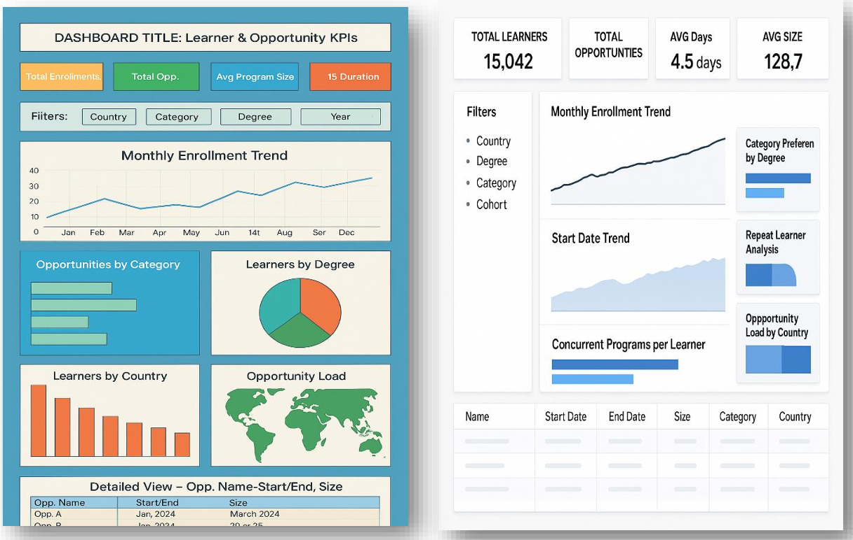
Week 3: Wireframe Design Principles
Sketch prepared on whiteboard and digitalized as annotated image
Structured layout:
Top: Summary KPIs
Left: Filter panel (Country, Degree, Category, Time range)
Center: and detailed bar charts
Right: Pie charts (DTime-seriesegree vs Category distribution)
Bottom: Interactive data table with drill‑down options

Slide 17
Week 3: Visual Rationale & Feedback
Design decisions annotated: filter placement, chart selection, hierarchy
Shared with team and mentors for feedback and alignment
Iterated wireframe twice before finalizing for dashboard build

Slide 18
Week 4: Deliverables
Completed the Google Looker studio dashboard with live data
Chat-like navigable charts, filters, and drill-downs for stakeholders
Final deliverables submitted: dashboard link, presentation slides, reflective video, 360° evaluation

Slide 19
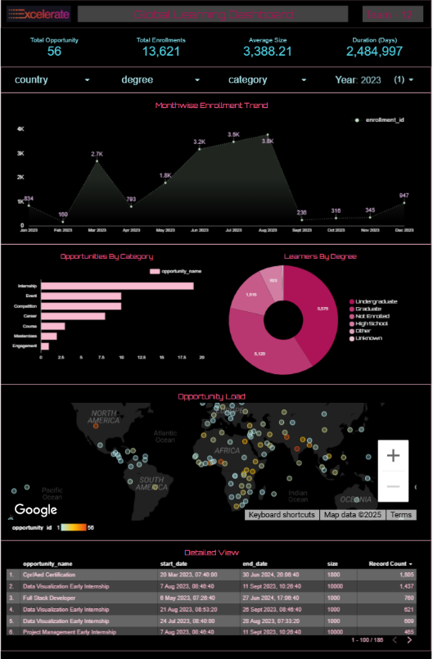
Week 4: Dashboard Features Screenshot
Preview of:
Interactive Scorecards
Filter-linked charts
Time-series trend view
Pie and bar breakdowns by category
Data table with export capability

Slide 20
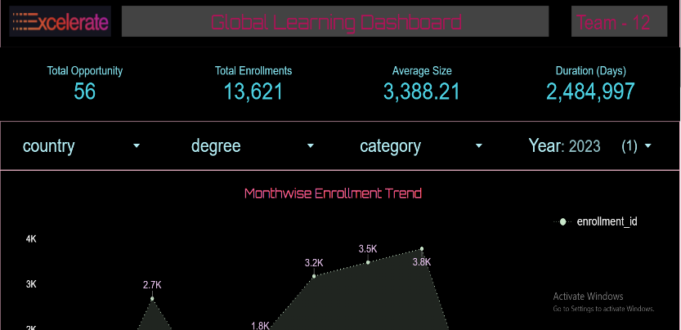
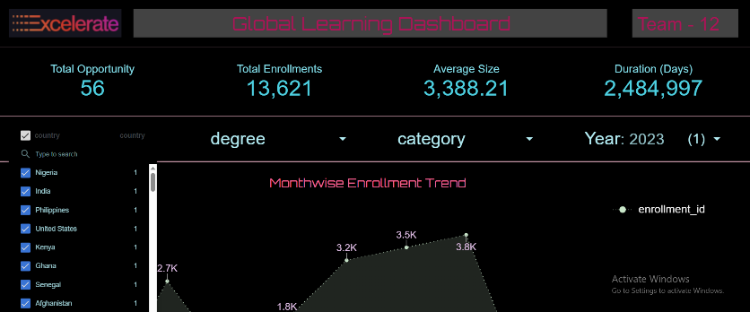
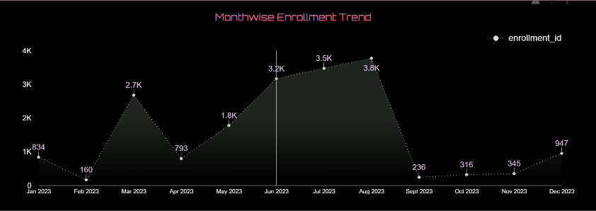
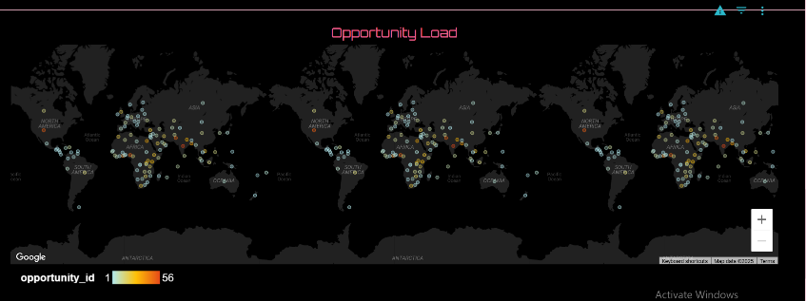
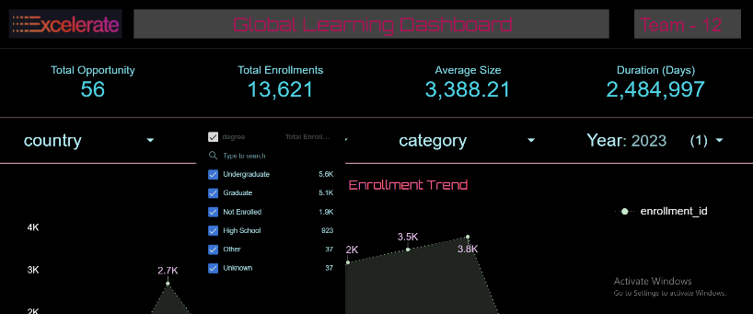
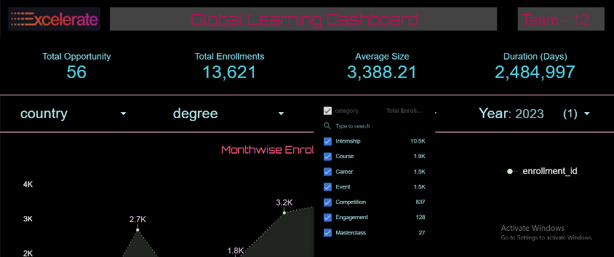
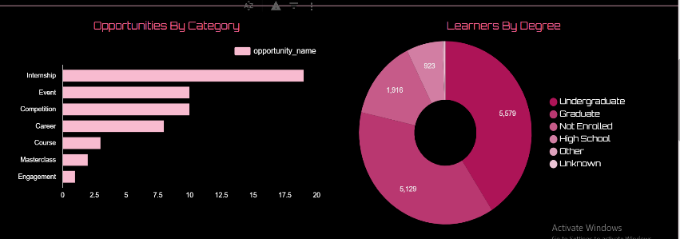
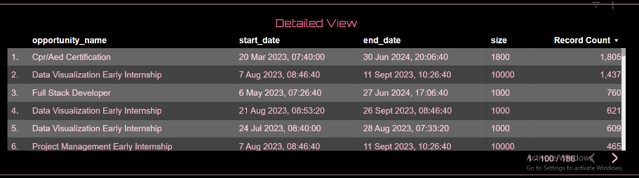
More screenshots that show interactiveness

Slide 21
Lessons Learned & Outcomes
This internship deepened our skills in SQL, data transformation, and ETL automation
It also reinforced best practices in EDA and visual storytelling using real‑world data
We learned the importance of data quality dimensions (accuracy, completeness, consistency, validity, uniqueness, timeliness)
Lastly, we gained a great experience presenting technical insights in a polished narrative format

Slide 22
THANK YOU!
Thankyou to the mentors and team Excelarate for the opportunity of this internship and for the guidance and support
Open to queries and feedback

